Slide 1
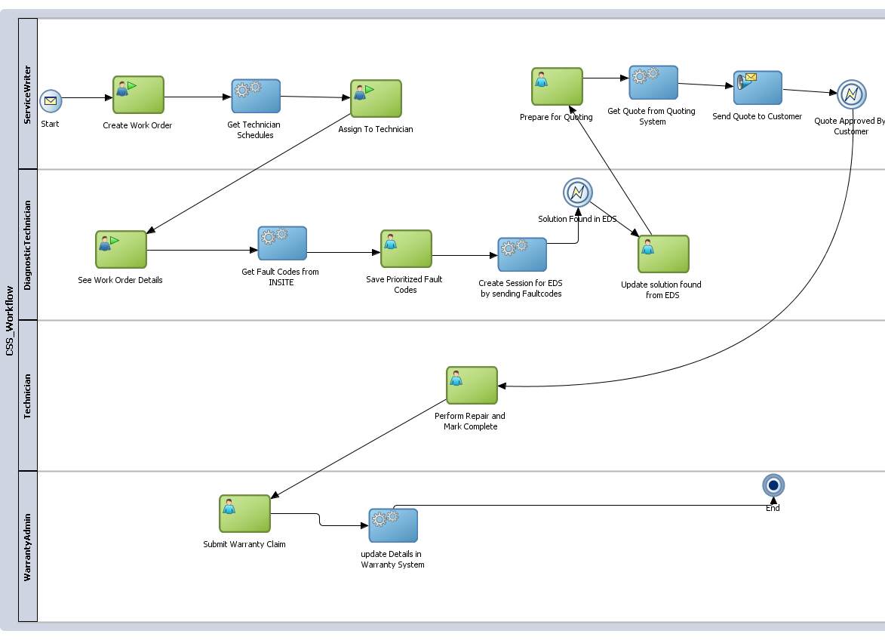
Cummins – Customer Service System Process

Slide 2




Service Writer
Cummins Service System
UX
Open Work Order
Determine Warranty Coverage
Find Available Technician
Service Writer
Store Process Info, Assigned Tech
Warranty System
Scheduling System
CSS will record the entire audit trail of the service event

Slide 3





Diagnostic Technician
ECM
Engine Fault Codes System
Assigned Technician Notified
Cummins Service System
UX
Review Work Order
Validate Customer Complaint
Fetch Fault Codes
Diagnostic Technician
Update Root Cause, Faulty Part Number,
Store Fault Image
Troubleshoot by downloading Manuals
Fetch Solution Tree for Faults
CSS
Business Management System
QSOL Manuals System
Expert Diagnostic System

Slide 4


Repair Technician
QSOL Manuals System
Quote Approved
Notification
Cummins Service System
UX
Review Work Order
View Solution
Fetch Repair Information
Repair Technician
Close Work Order
REPAIRED
Additonal Repair Content
View Diagnostic Images
CSS
Business Management System
CSS will record the entire audit trail of the service event

Slide 5

Warranty Administrator
Warranty System
Repair Complete Notification
Cummins Service System
UX
Review Work Order
Submit Warranty Claim
Warranty Administrator

Slide 6





Conceptual Architecture for Cummins Service System (CSS)
Multi-Channel
API
INSITE
Federated Sign-On
Siteminder
Create Work Order
Get Fault Codes
Get Solution Tree
Generate Quote
Seamless connectivity
Cummins Digital Hub
EDS

